Slide 1
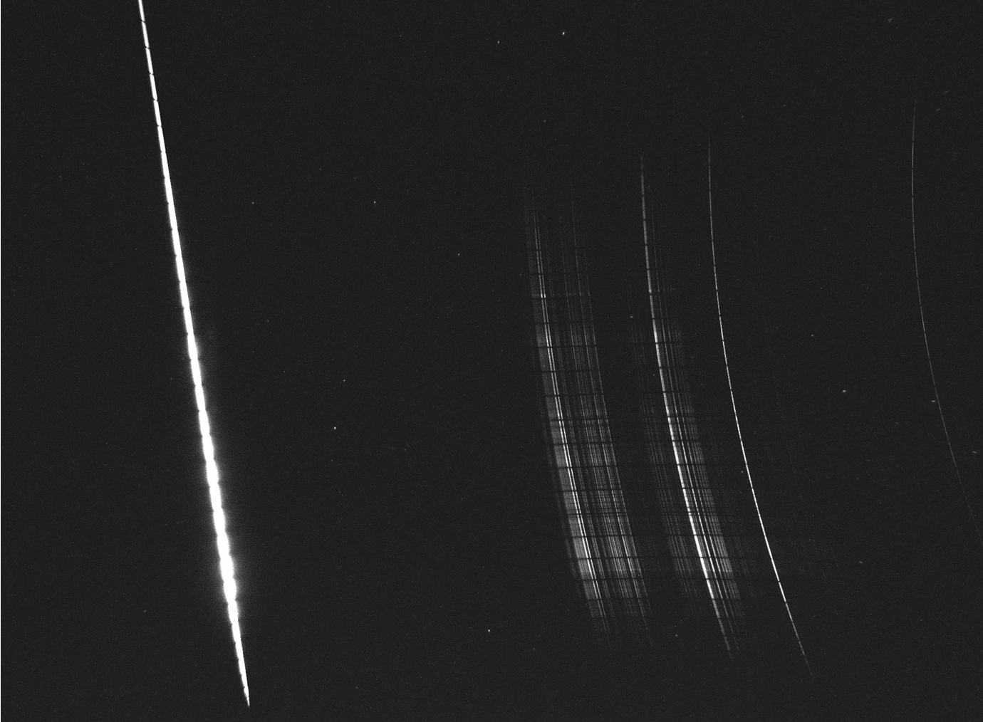
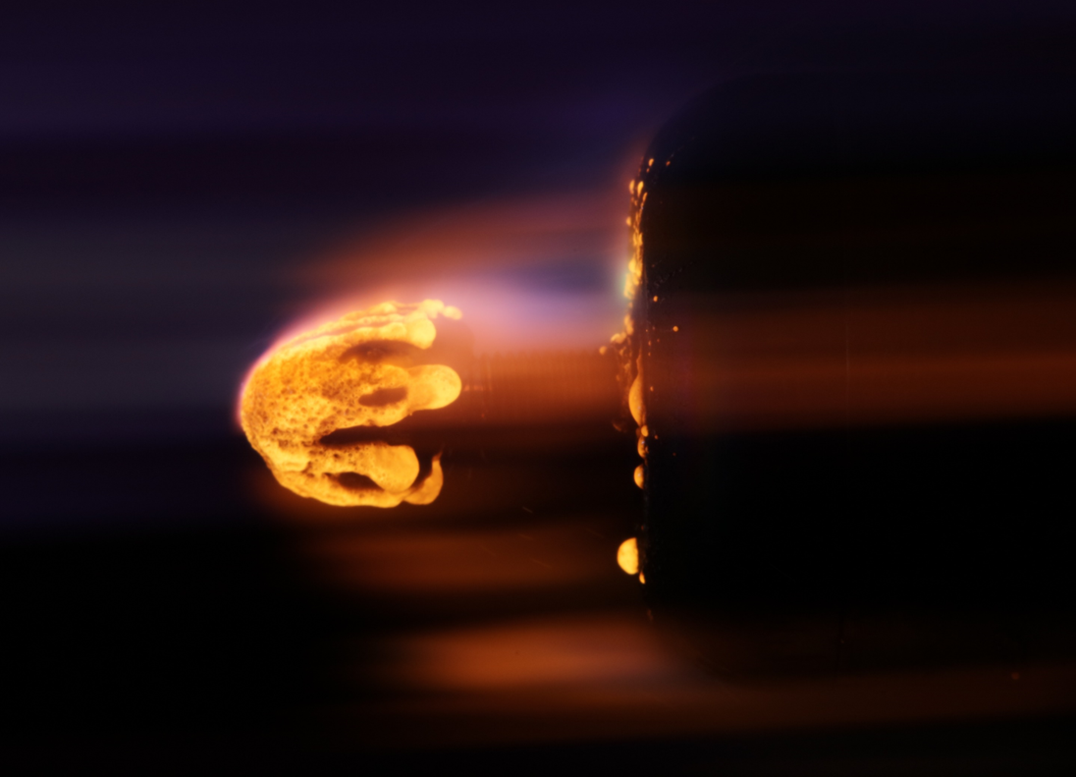
Spectral properties of ablating meteorites for improved meteoroid composition diagnostics
P. Matlovič¹, A. Pisarčíková¹, V. Pazderová¹, S. Loehle², J. Tóth¹, L. Ferriere³, P. Čermák¹, D. Leiser², J. Vaubaillon⁴, R. Ravichandran^{2,5}
¹ Faculty of Mathematics, Physics and Informatics, Comenius University Bratislava, Slovakia
² Institute of Space Systems, University of Stuttgart, Germany
³ Natural History Museum Vienna, Austria
⁴ IMCCE, Observatoire de Paris, France ⁵ Institute of Advanced Engineering and Space Sciences, University of Southern Queensland, Australia

Slide 2
Motivation
Previous spectral surveys mostly based on lower-resolution data
Captured spectral differences based on a few lines - recognition of irons, thermally altered meteoroids (Na), most meteors appear chondritic-like
Systematic link to meteoroid composition type missing
Goals:
Provide reference spectra of different meteorites (asteroid meteor analogs)
Identify diagnostic spectral features for specific meteorite classes
Validate a radiative transfer model for meteoric plasma

Slide 3
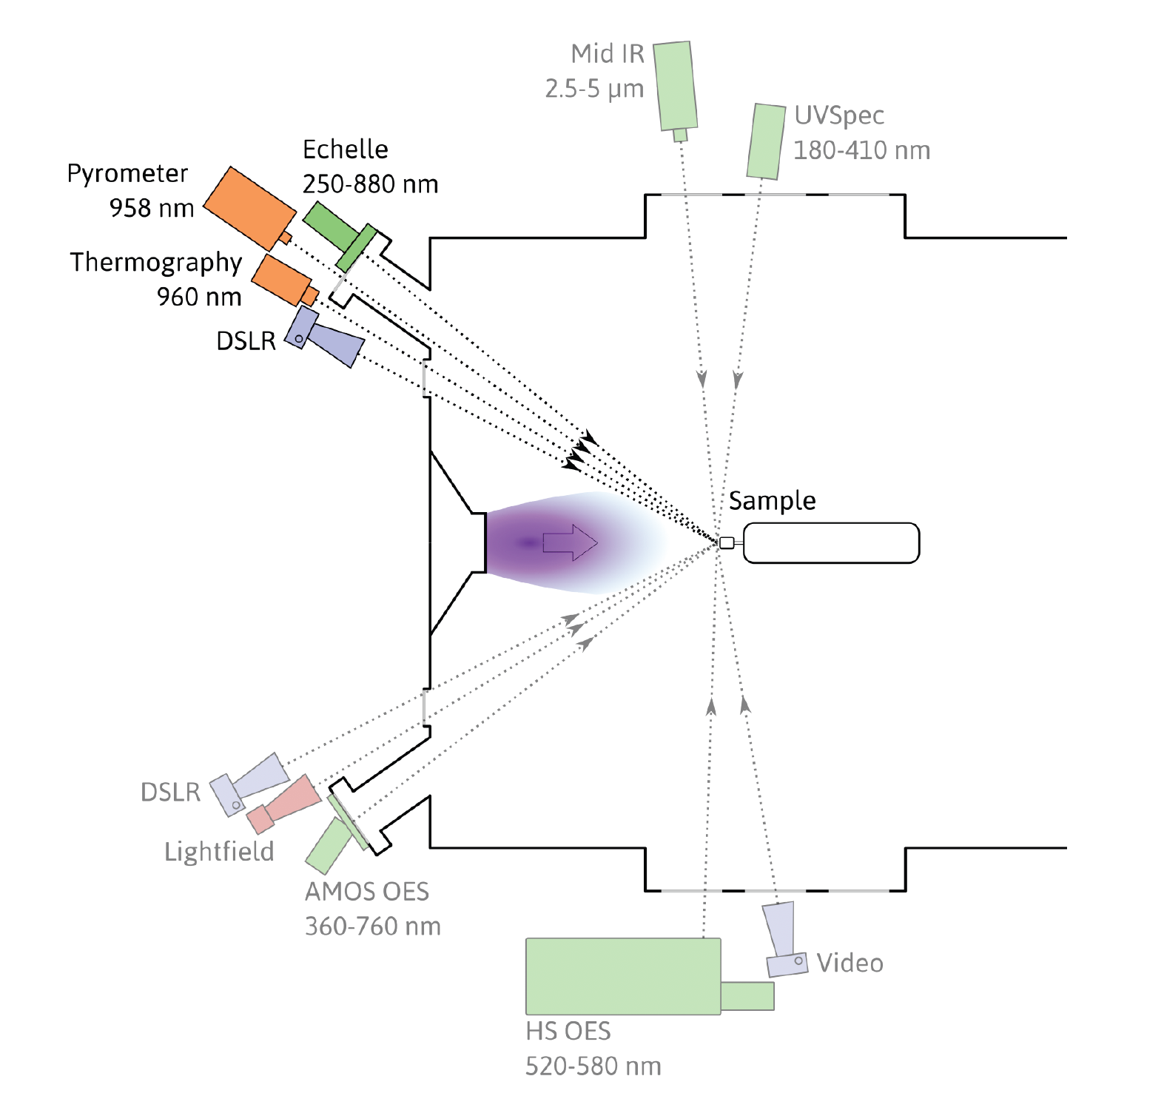
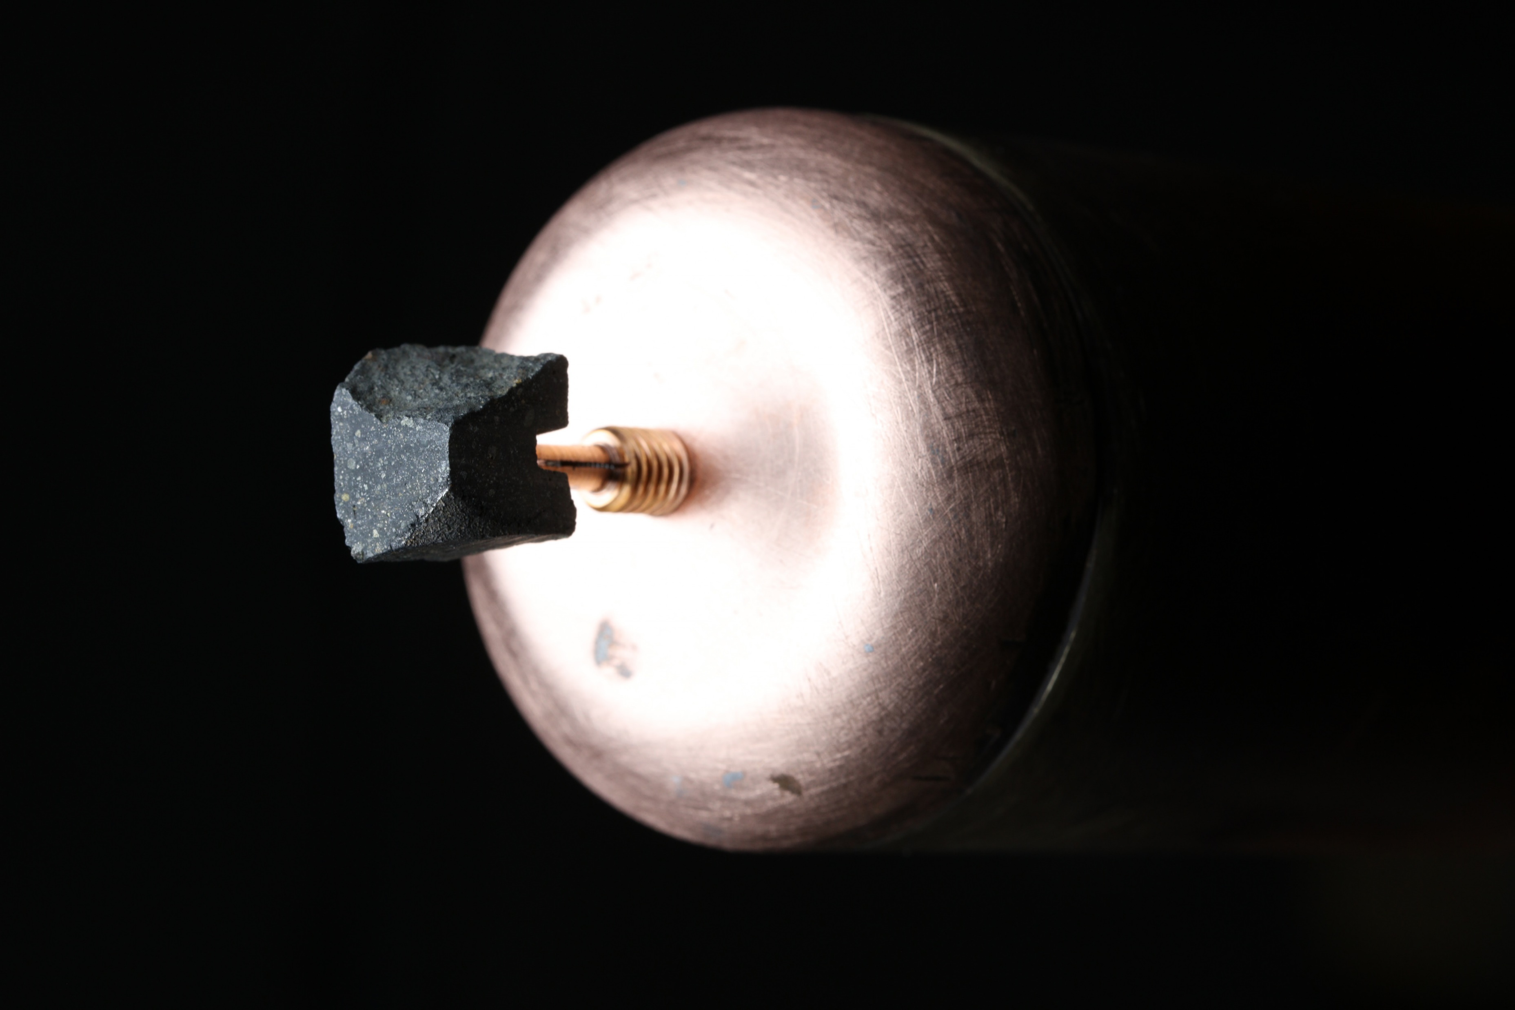
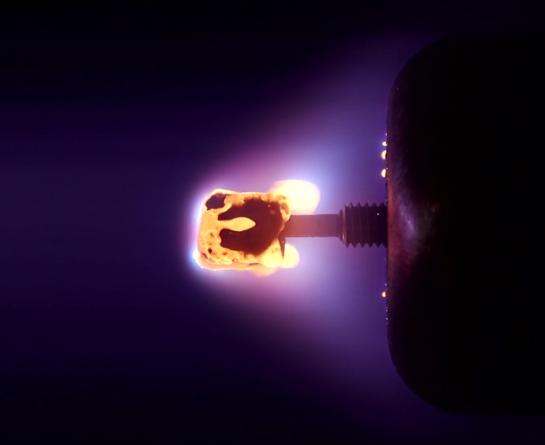
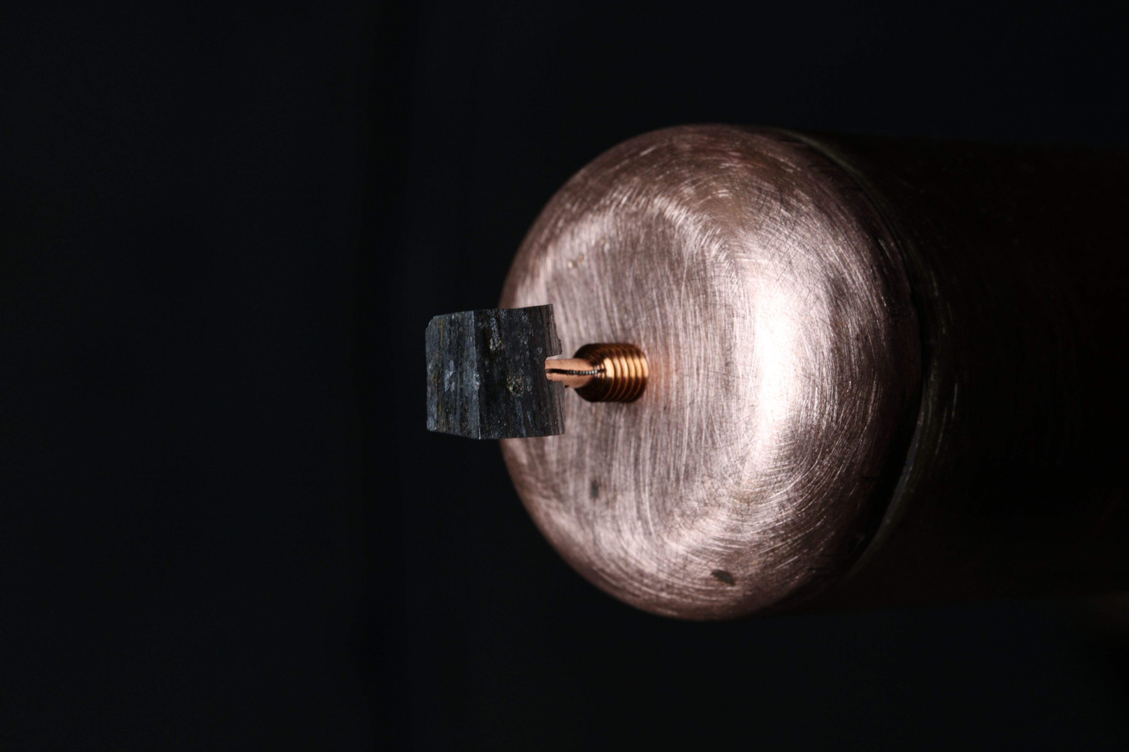
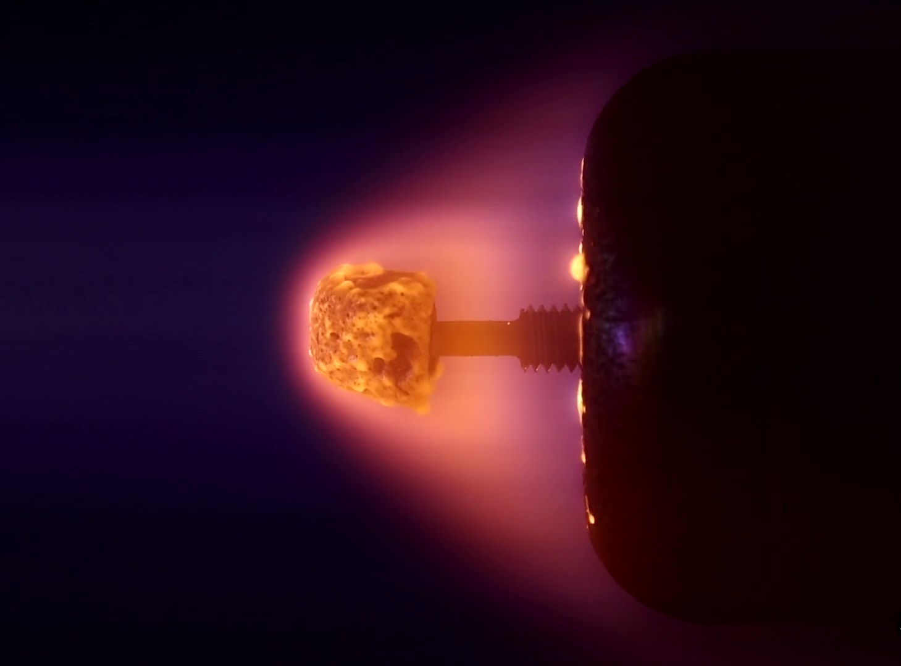
ESA MetSpec experiments
28 experiments using 22 meteorites
Captured by 11 instruments
Corresponding to a 12 km/s meteor at 80 km
Prior LIBS measurements
→
→

Slide 4
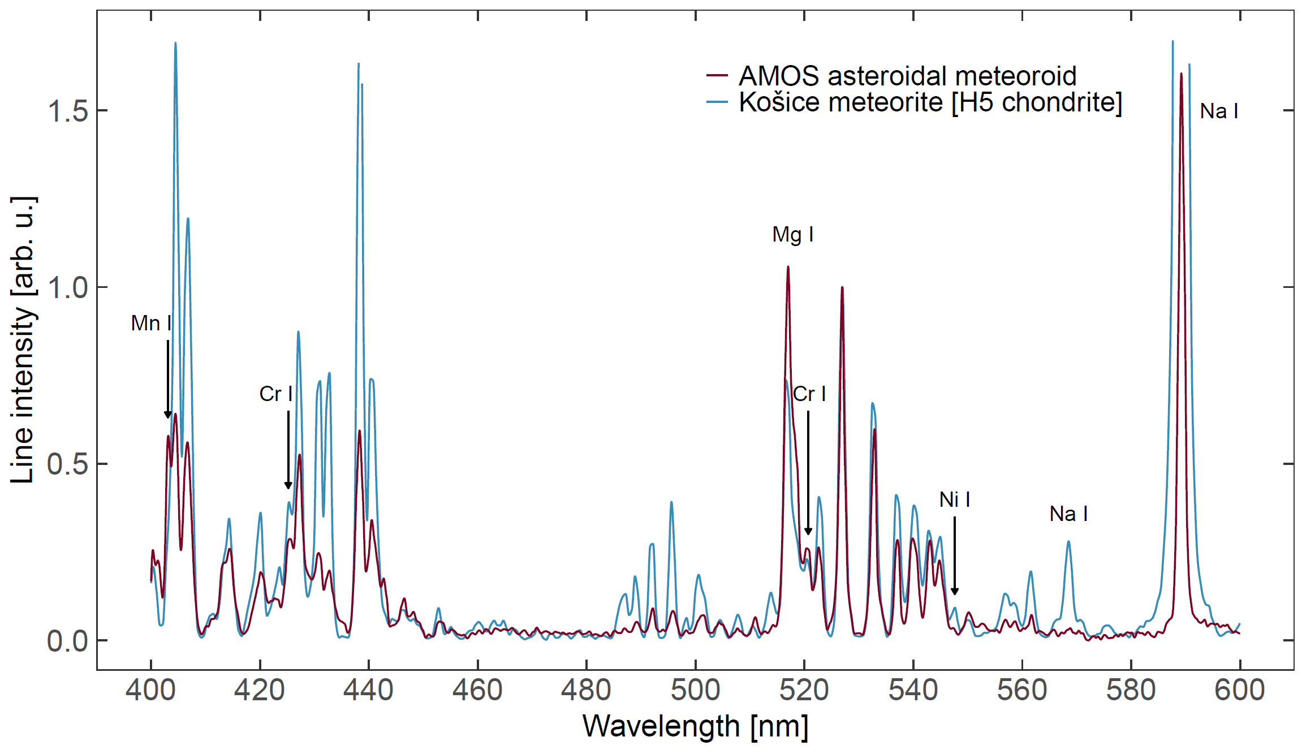
Analogues to asteroidal meteors

Slide 5
Meteorite emission spectra

Slide 6
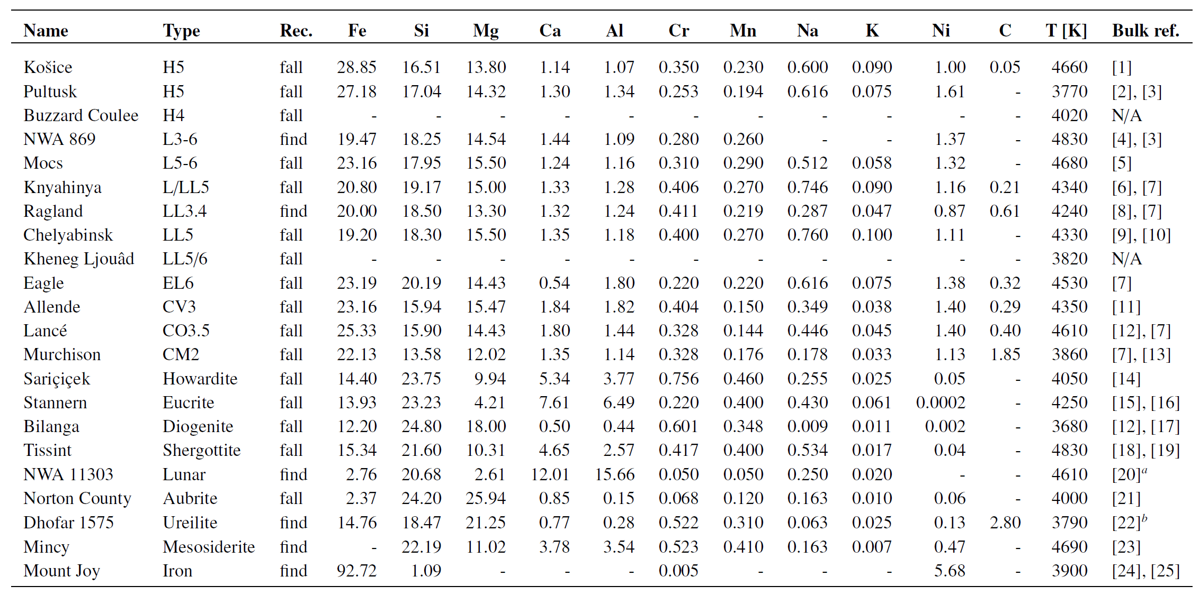
Tested meteorites

Slide 7
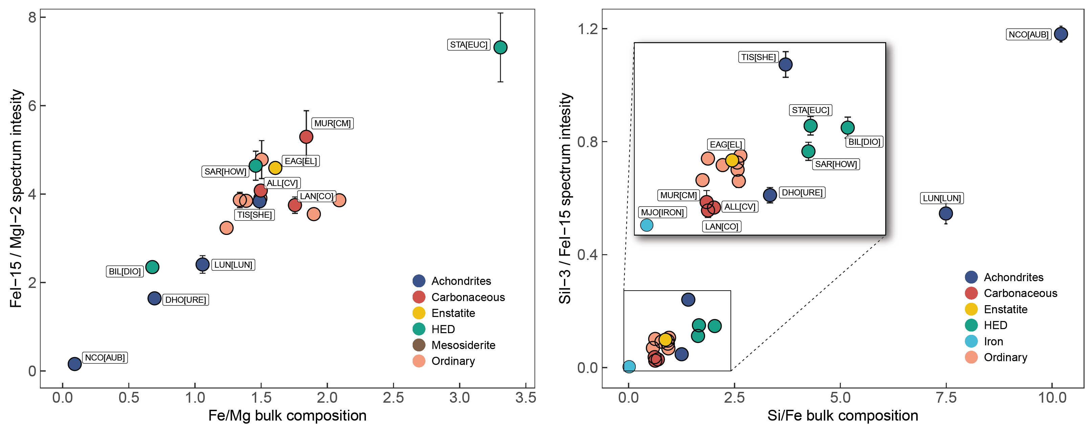
Line intensities vs. bulk composition

Slide 8
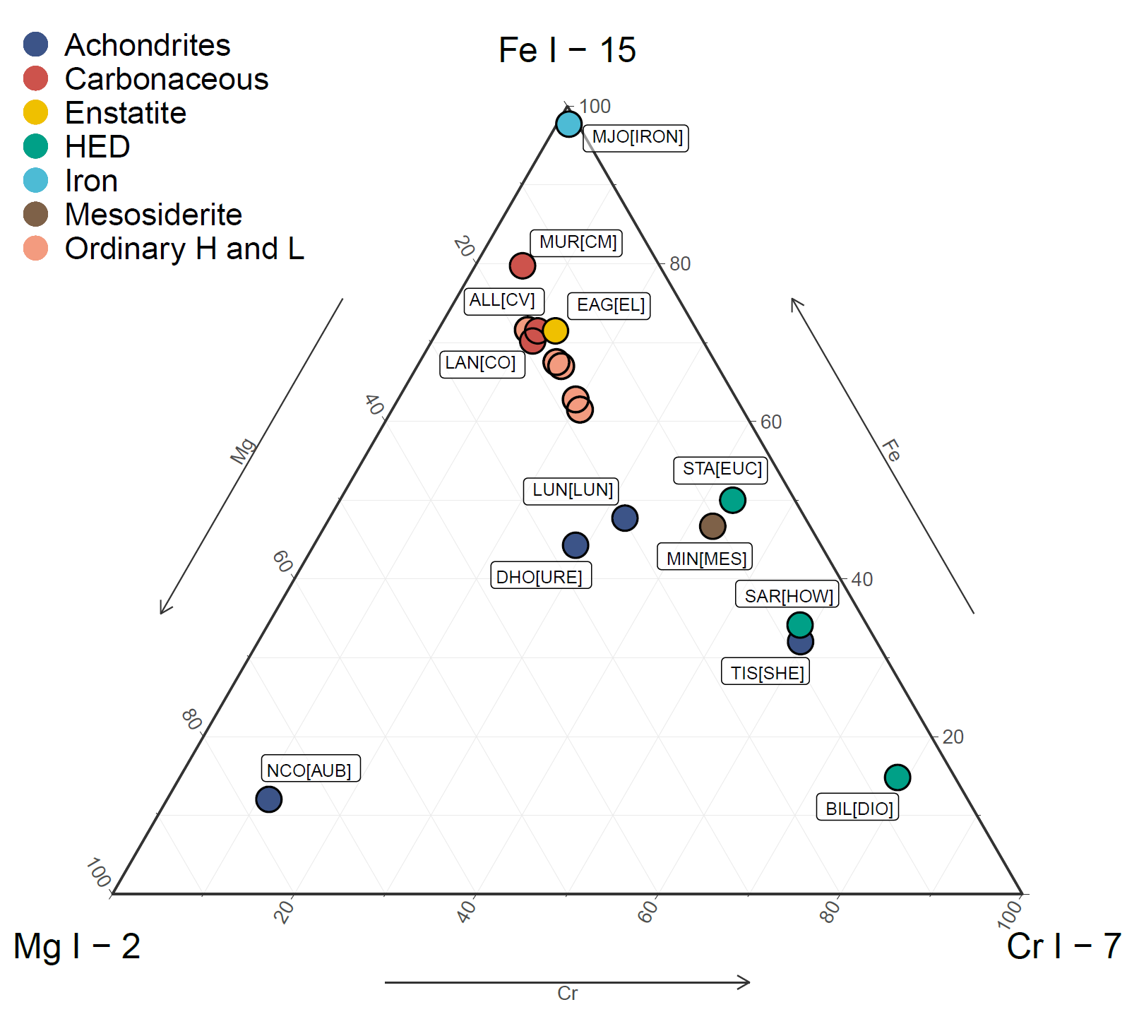
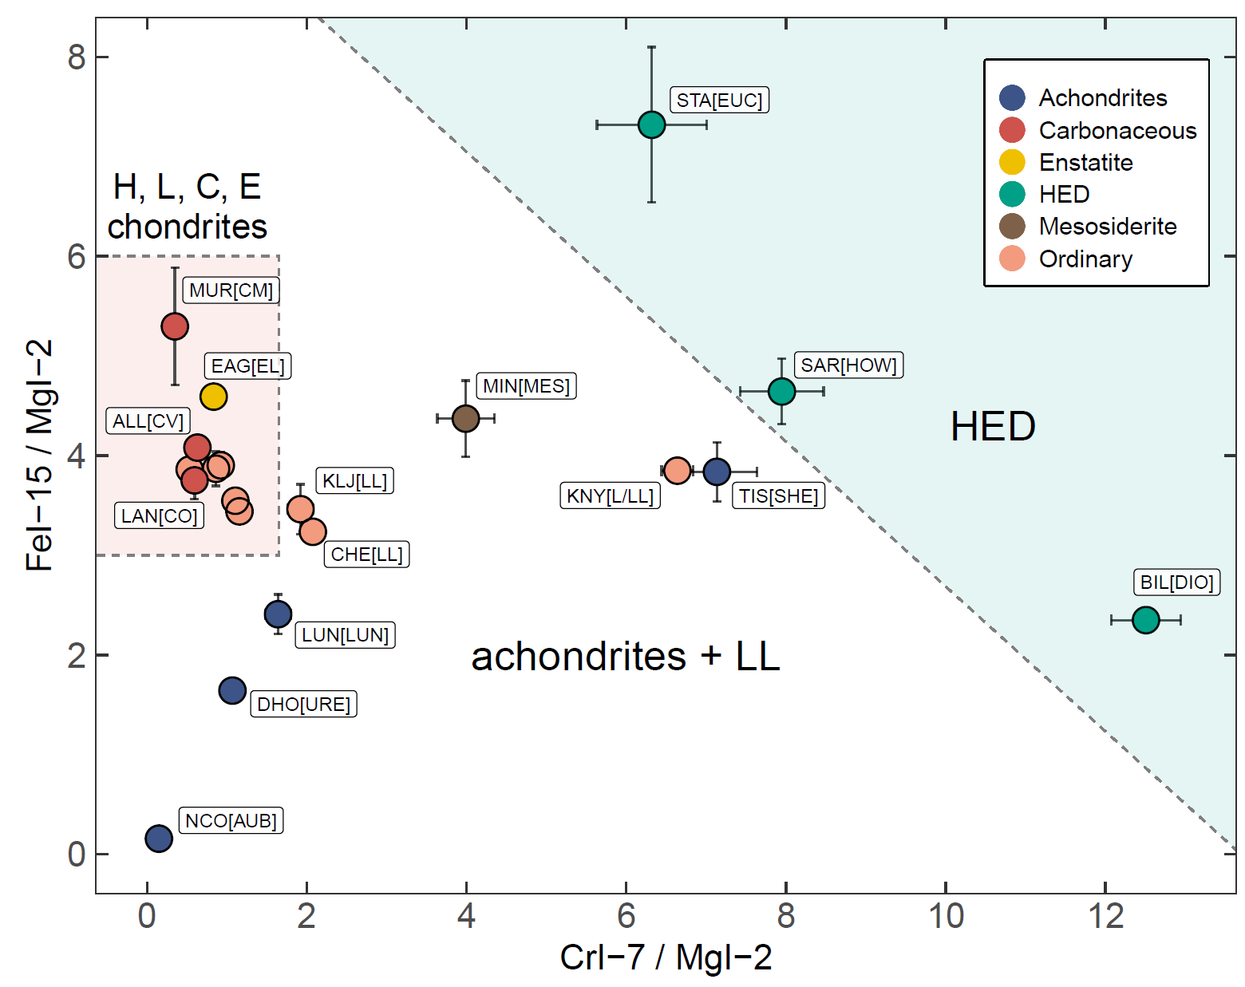
Diagnostic features: Fe, Mg, Cr

Slide 9
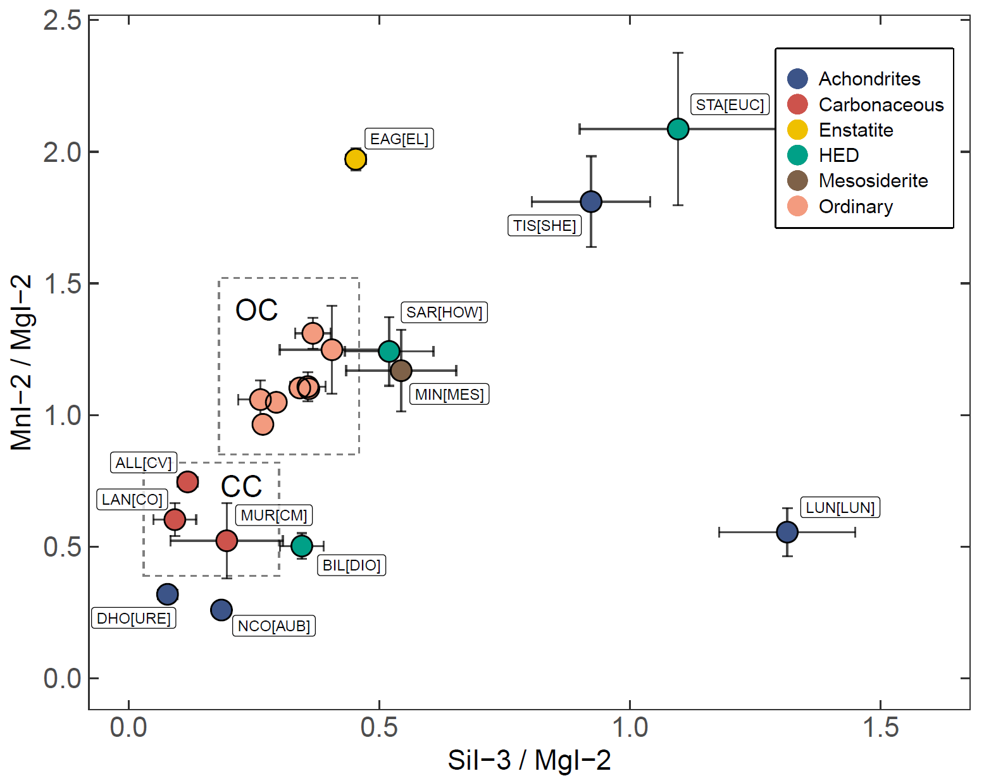
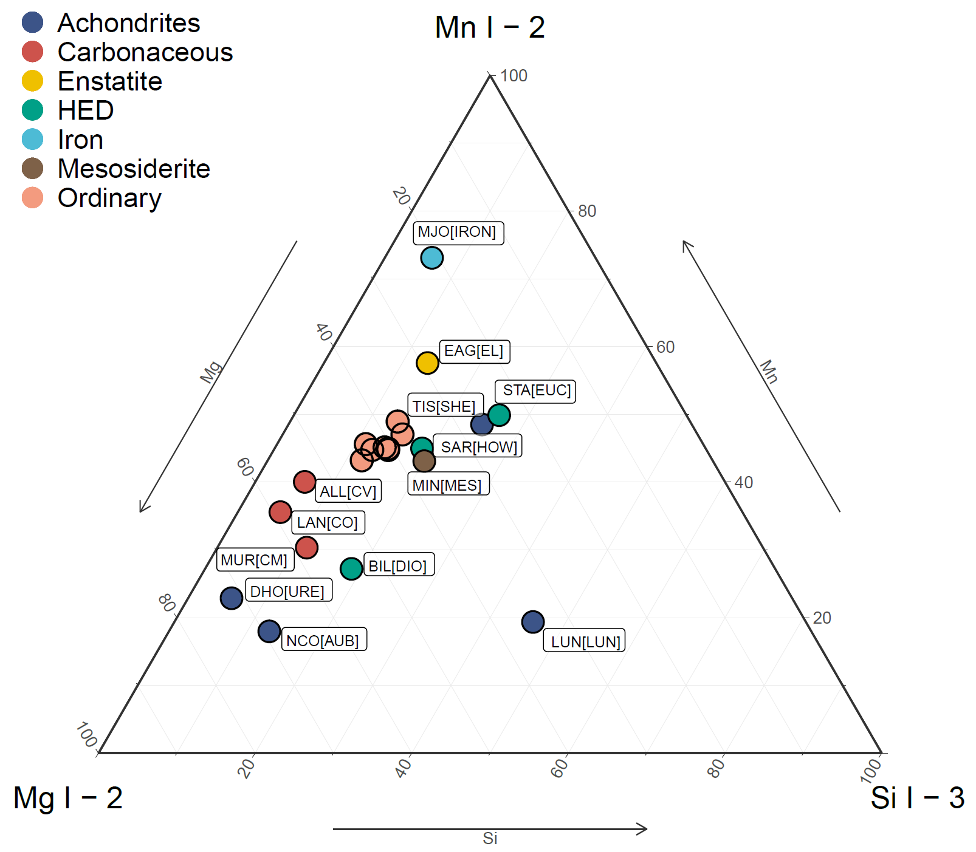
Diagnostic features: Si, Mn

Slide 10
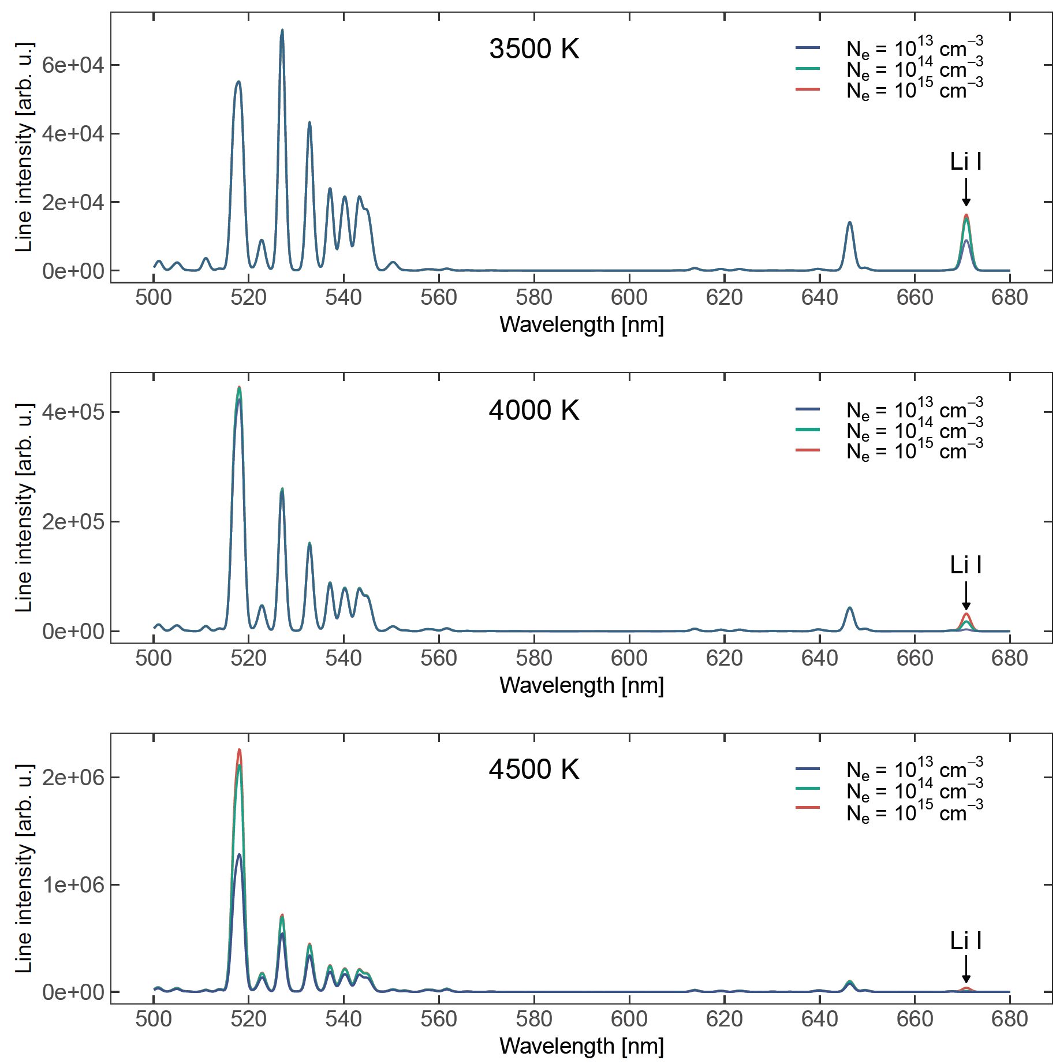
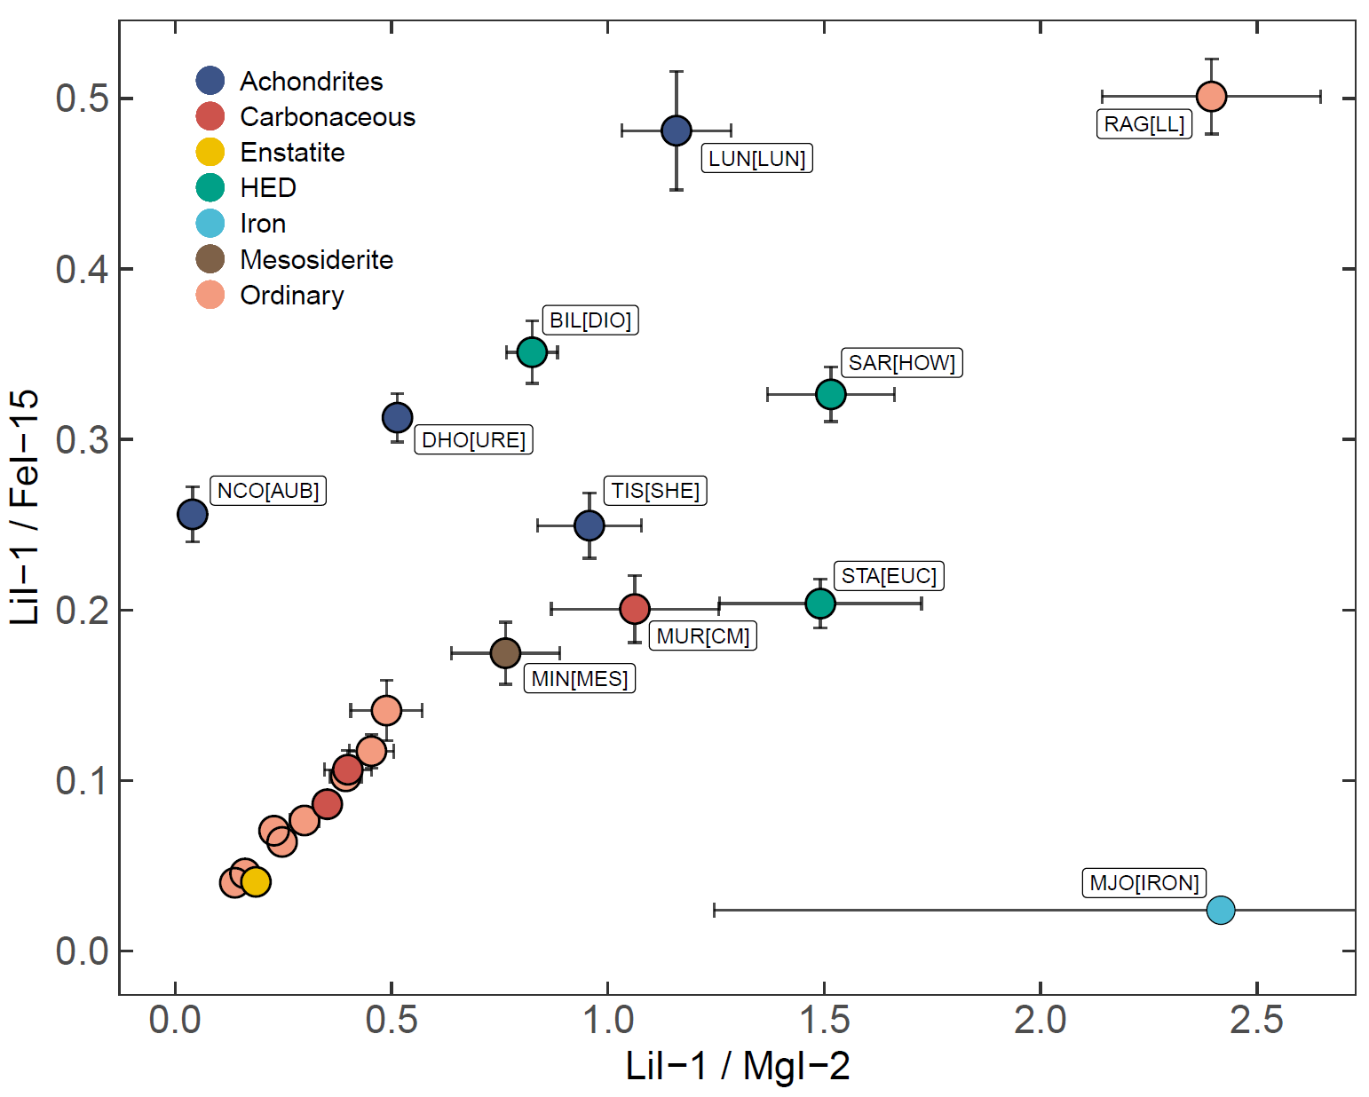
Diagnostic features: Li

Slide 11
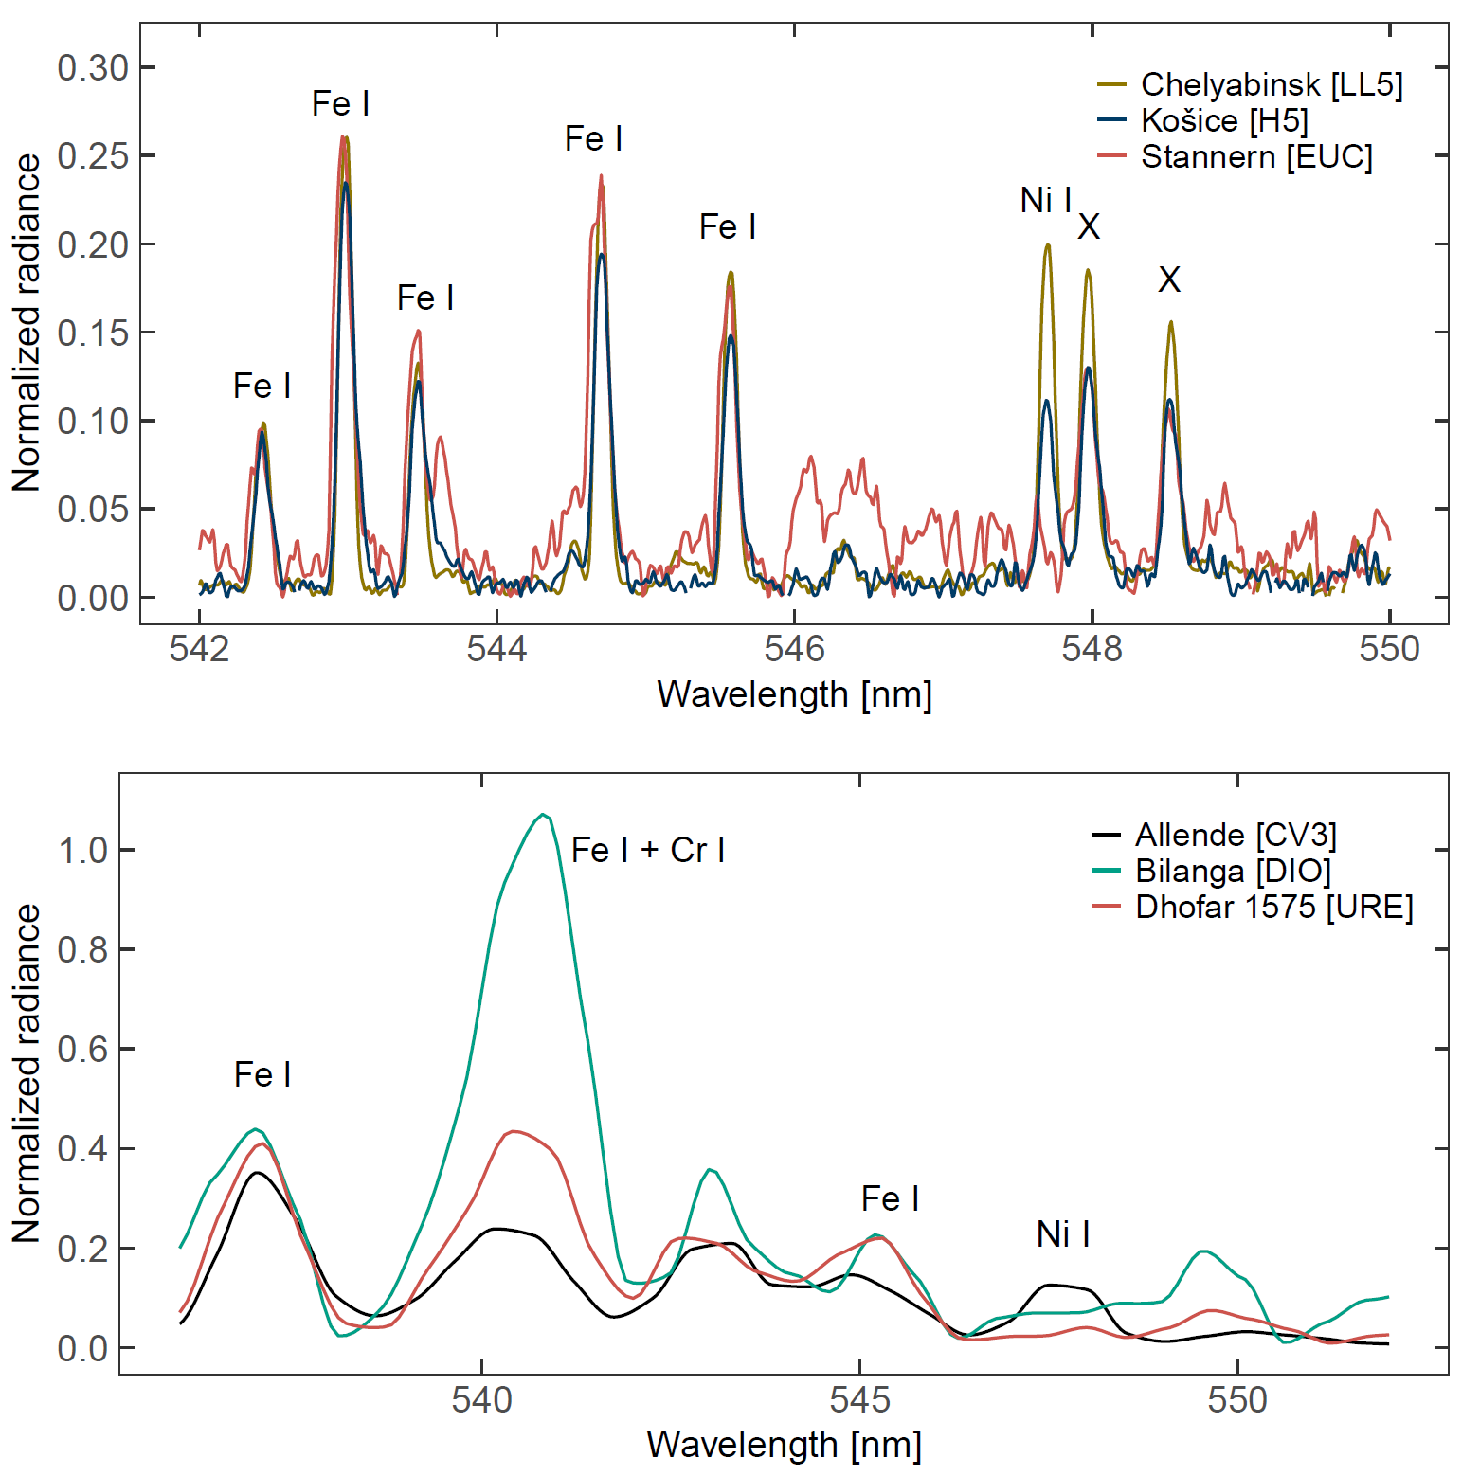
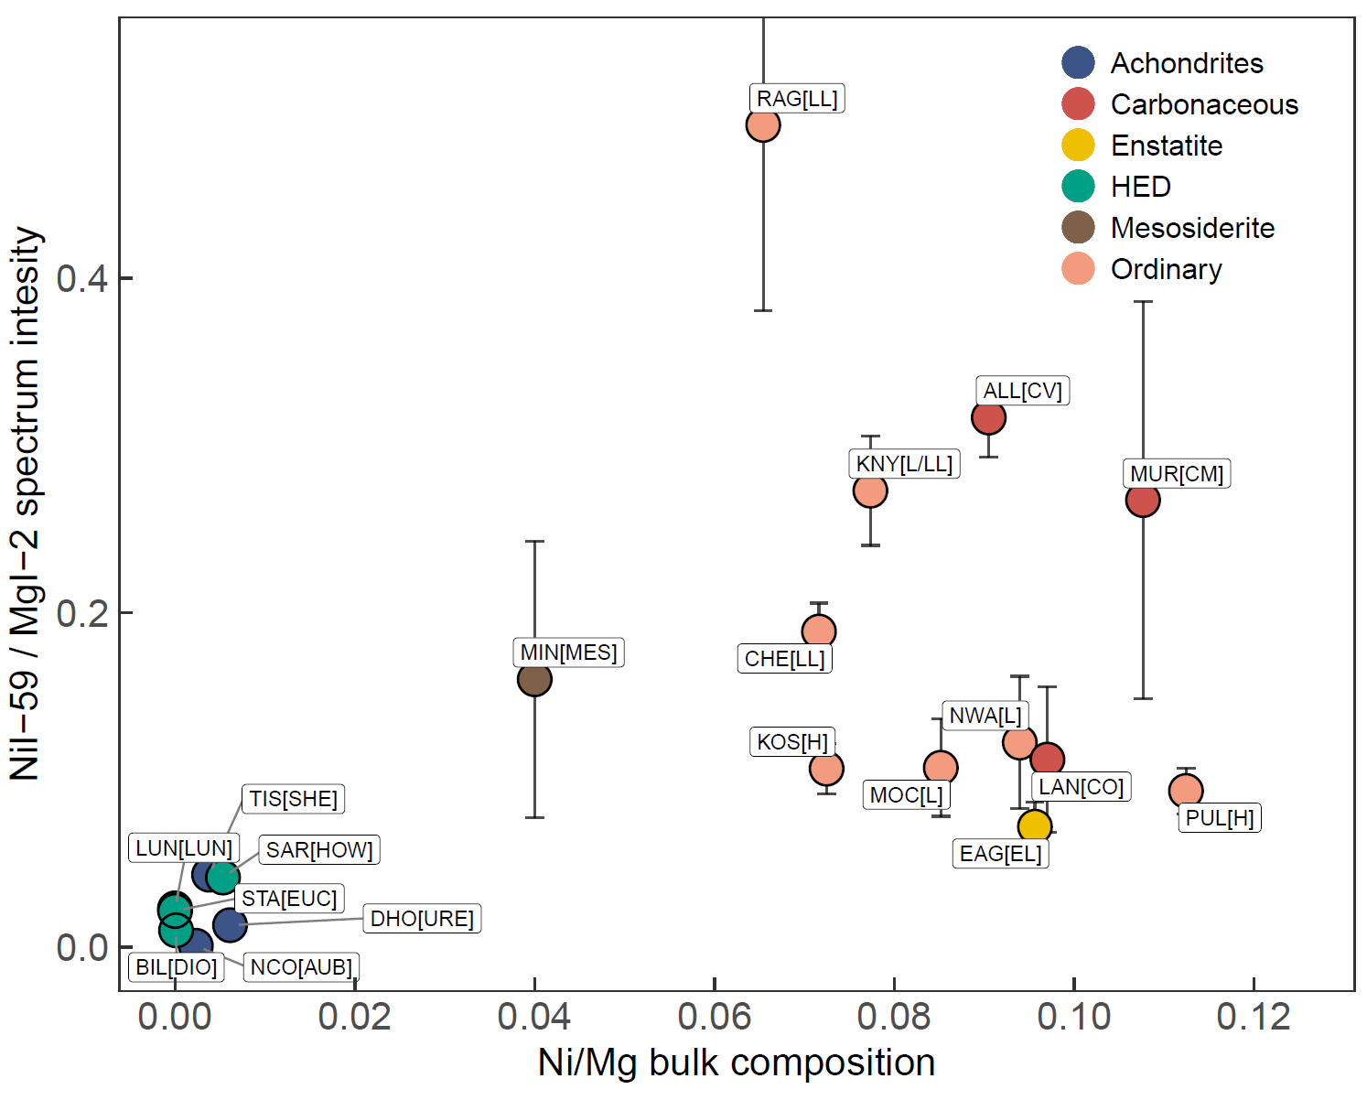
Diagnostic features: Ni
Most chondrites contain 1.0 - 1.8 wt% Ni
Most achondrites < 0.1 wt%
Few well-resolved lines, the best Ni I-59 at 547.69 nm

Slide 12
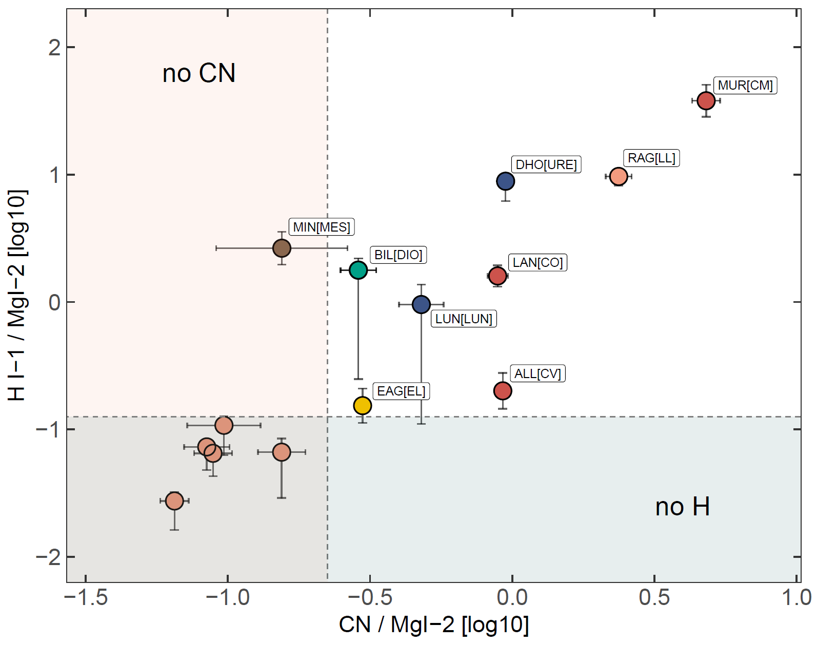
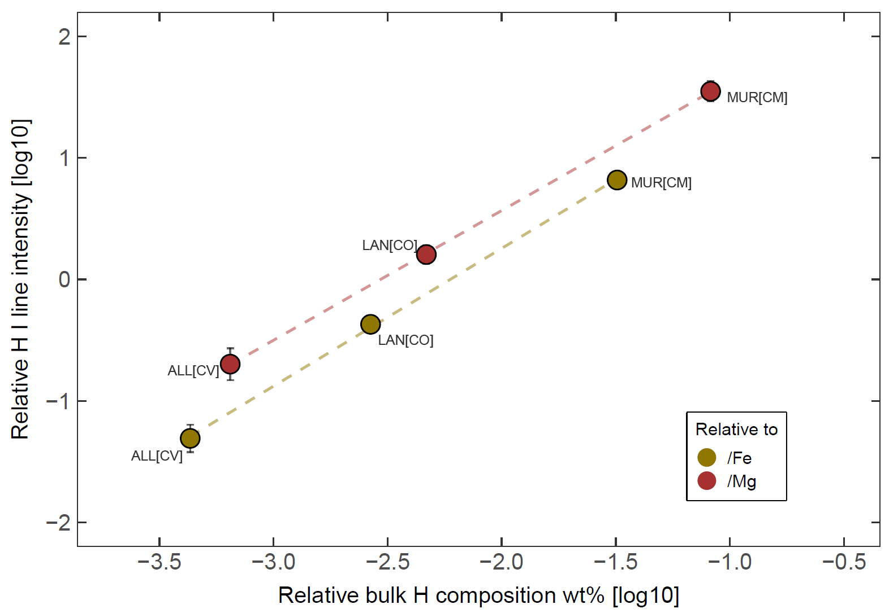
Presence of water and organics
Hα and CN emission tracing the presence of hydrated minerals and organic compounds - Matlovič et al., MNRAS (2022) - Pisarčíková et al., Icarus (2023)
Identification of carbonaceous, cometary bodies
Thermal excitation of H requires higher temperatures (fast meteors), excitation from electron impacts likely contributed at lab conditions

Slide 13
Minor species and refractory elements
Lack of refractory elements: Ca, Ti, Al
Confirmed incomplete evaporation of these species during the ablation - previously suggested from fireball spectra analysis (Borovička, 1993)
Other identified minor species: Co I, Cu I, and V I

Slide 14
Spectral distinction – notable regions

Slide 15
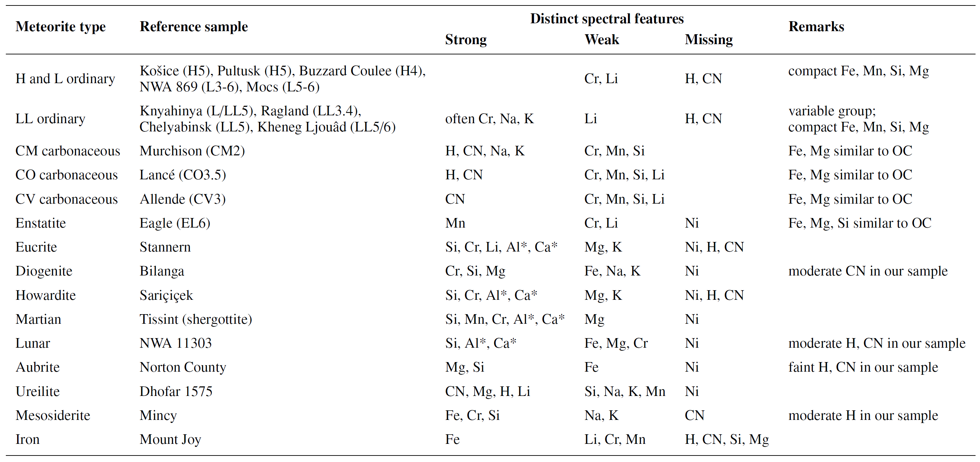
Summary

Slide 16
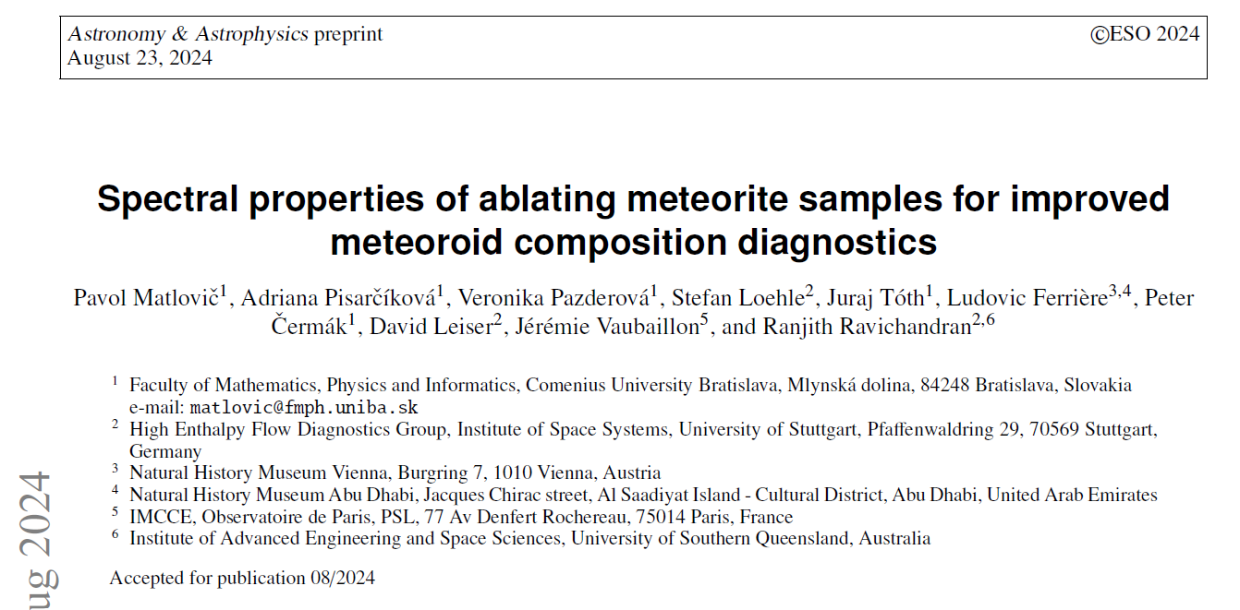
Conclusions
First catalog of high-resolution spectra of a diverse range of meteorite types
Identified diagnostic spectral features, including tracers of hydrated minerals and organics
Determined plasma temperatures of meteorite ablation 3700 – 4800 K
Confirmed incomplete evaporation of Ca, Ti, Al
Confirmed presence of minor species Co I, Cu I, V I

Slide 17
Future plans
Analysis of identified features in large meteor datasets
Modeling of changes in spectral properties at different temperatures
Spectrum fit using radiative transfer model – estimation of relative abundances
Search for CN emission from meteors
Upgrade of AMOS spectrographs

Slide 18
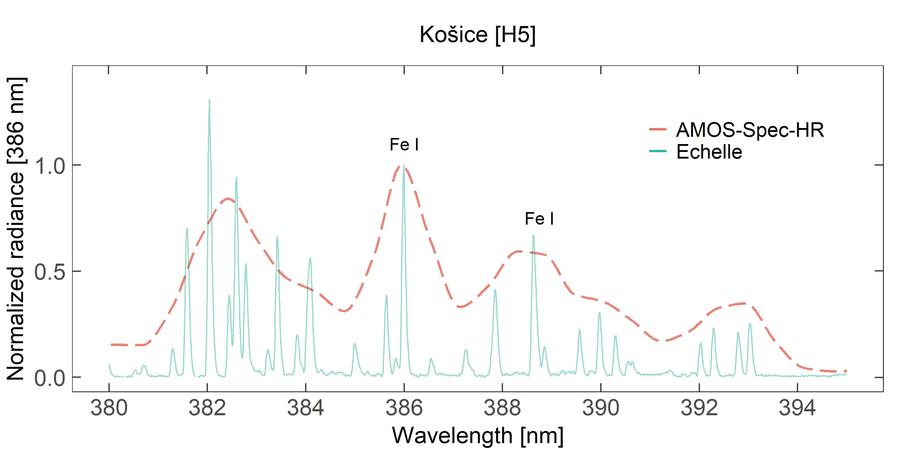
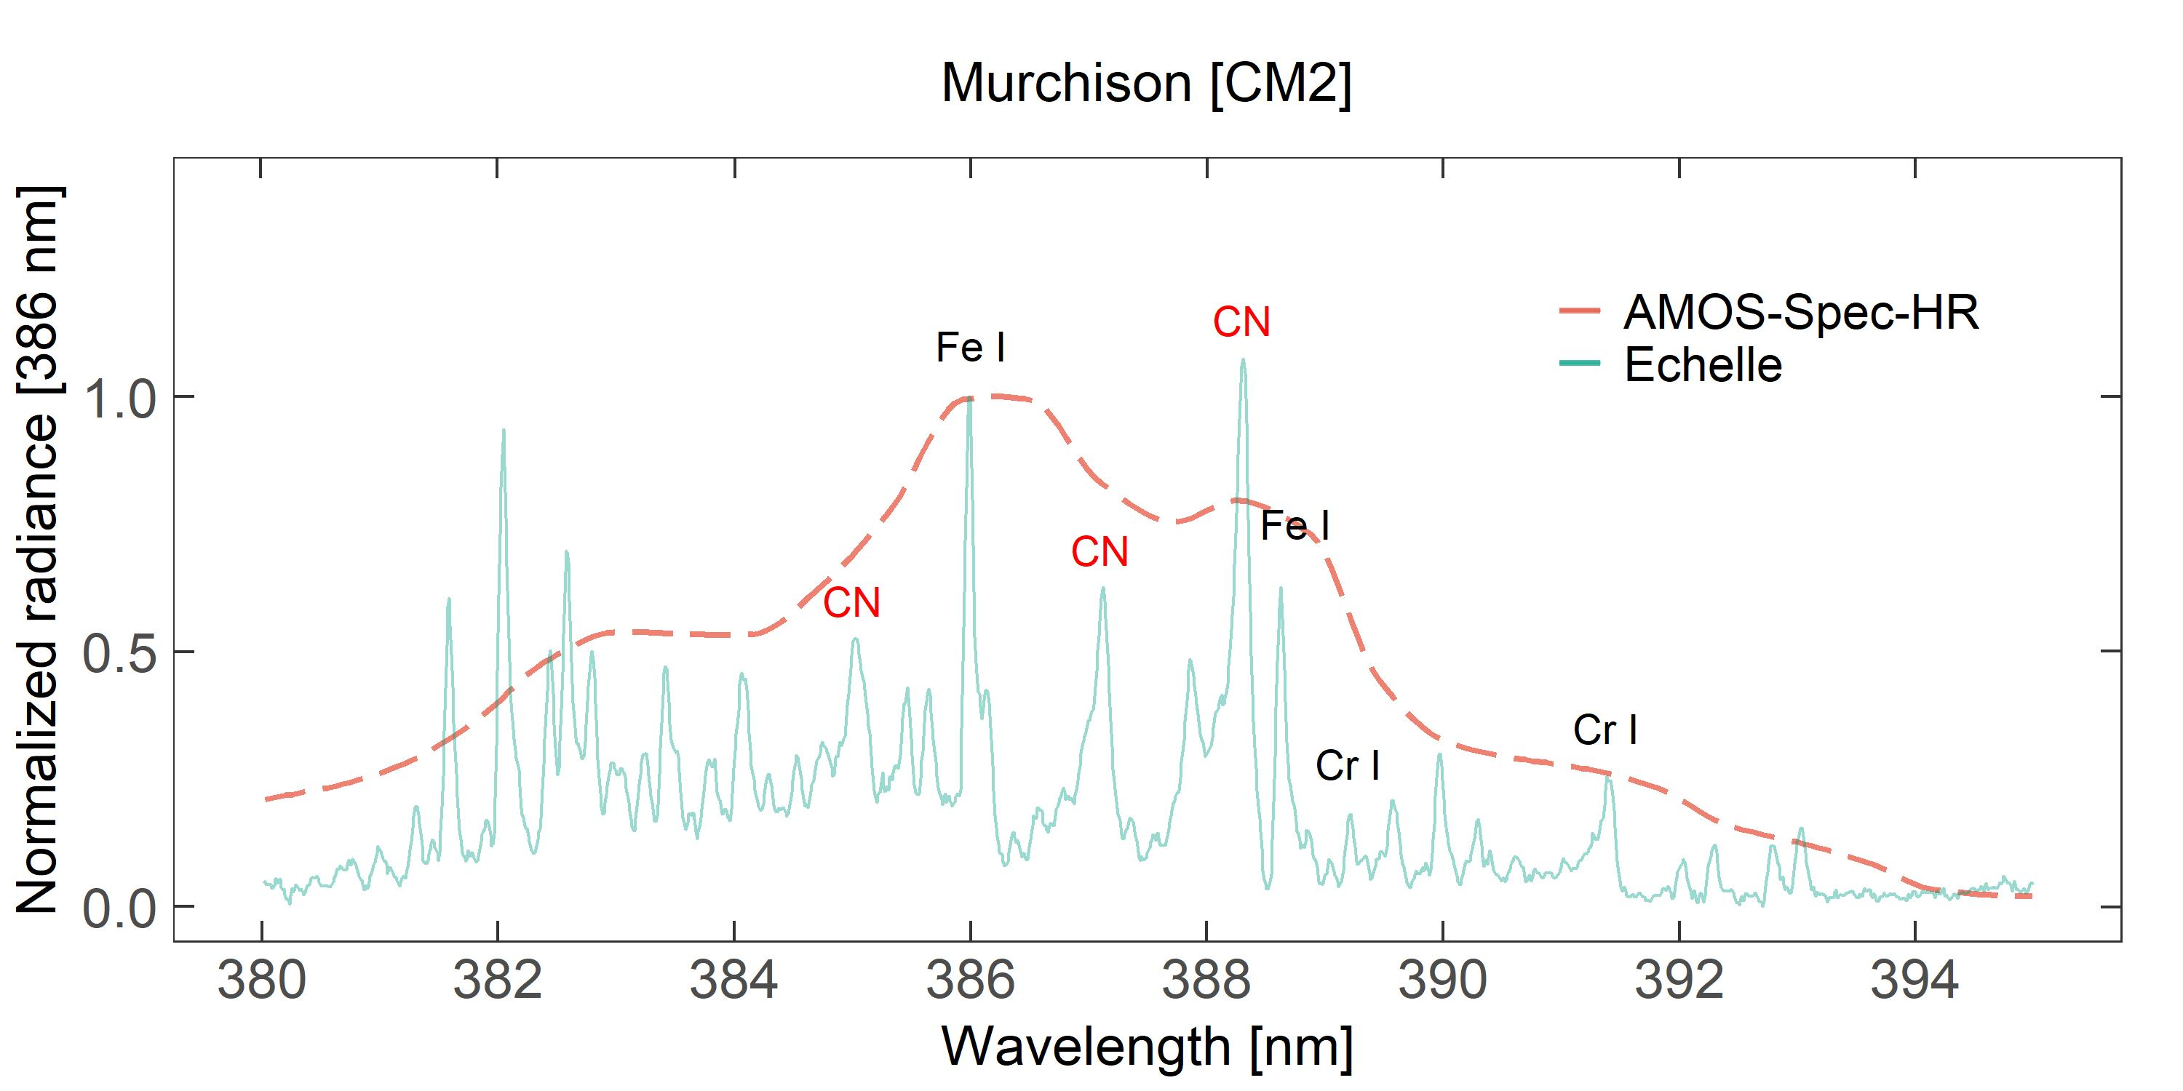
CN in meteors
Application in lower resolution AMOS spectra:
increased 388.3/386.0 nm peak and decreased line width ratio

